Slide 1

4 BIT ARITHMATIC & LOGIC SHIFT UNIT
Harshil Patel

Slide 2
What is ALU ?
In computing, an arithmetic logic unit (ALU) is a combinational digital circuit that performs arithmetic and bitwise operations on integer binary numbers.
It is a fundamental building block of many types of computing circuits, including the central processing unit (CPU) of computers, FPUs, and graphics processing units (GPUs).
The inputs to an ALU are the data to be operated on, called operands, and a code indicating the operation to be performed; the ALU's output is the result of the performed operation.
In many designs, the ALU also has status inputs or outputs, or both, which convey information about a previous operation or the current operation, respectively, between the ALU and external status registers.
ARITHMETIC & LOGIC SHIFT UNIT(ALU)
ARITHMETIC UNIT
LOGIC UNIT
SHIFT UNIT

Slide 3
ARITHMETIC MICRO OPERATION
Arithmetic micro-operations are basic operations that perform actions on numeric data stored in registers.
The six basic arithmetic micro-operations are:
Add
Subtract
Compliment
Increment
Decrement
1's complement

Slide 4
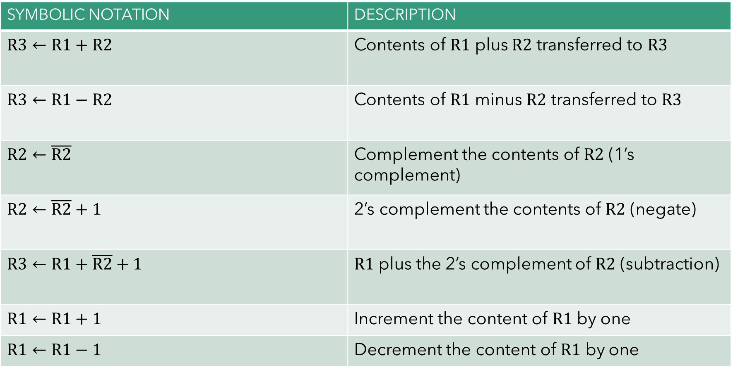
ARITHMETIC MICRO OPERATION
SYMBOLIC NOTATION | DESCRIPTION
$$R3←R1+R2$$ | Contents of $R1$ plus $R2$ transferred to $R3$
$$R3←R1−R2$$ | Contents of $R1$ minus $R2$ transferred to $R3$
$$R2←\overline{R2}$$ | Complement the contents of $R2$ (1’s complement)
$$R2←\overline{R2}+1$$ | 2’s complement the contents of $R2$ (negate)
$$R3←R1+\overline{R2}+1$$ | $R1$ plus the 2’s complement of $R2$ (subtraction)
$$R1←R1+1$$ | Increment the content of $R1$ by one
$$R1←R1−1$$ | Decrement the content of $R1$ by one

Slide 5
4 BIT ARITHMETIC CIRCUIT
There are 3 components in ALU :
1. Arithmetic Unit (4-bit) :
There are basically two components used in the Arithmetic Unit. 1. 4 to 1 Multiplexer (MUX) 2. Full adder There are four 4:1 MUX and four Full Adders in my circuit. this arithmetic unit can perform 7 operations, including add, subtract, transfer, etc. 2 figure 2.1. 4-bit Arithmetic
2. Logical Unit (4-bit) :
There are four 4:1 MUX and 4 pairs of AND, OR, XOR, and NOT gates. In my circuit, we can perform the NOT operation on both inputs A and B. This Logic unit can perform 16 different logic operations that can be performed with two binary variables, including NAND, XOR, complement A, etc.
3. Combinational Circuit Shifter (4-bit): right shift, left shift :
A combinational circuit shifter can be constructed with multiplexers. The 4-bit shifter has four data inputs and four data outputs. There are two serial inputs, one for shift left and the other for shift right. When the selection input is 0, the input data are shifted right. When 1, the input data are shifted left.

Slide 6
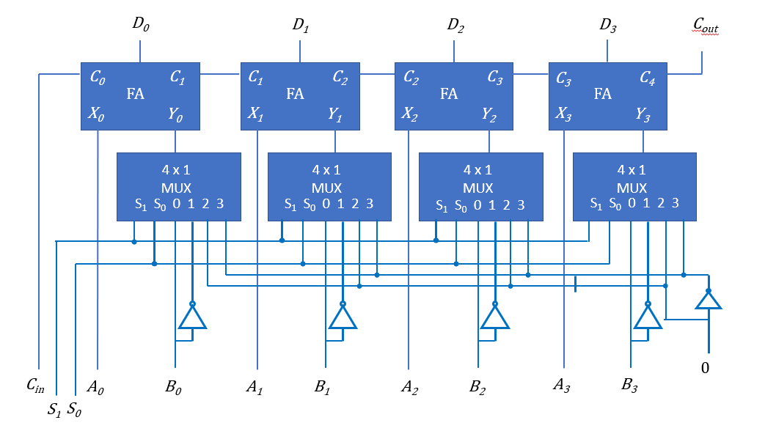
4 BIT ARITHMETIC UNIT

Slide 7
4 BIT ARITHMETIC UNIT
S₁ | S₀ | C_{in} | Y | D = A + Y + C_{in} | Microoperation
0 | 0 | 0 | B | D = A + B | Add
0 | 0 | 1 | B | D = A + B + 1 | Add with carry
0 | 1 | 0 | B’ | D = A + B’ | Subtract with borrow
0 | 1 | 1 | B’ | D = A + B’ + 1 | Subtract
1 | 0 | 0 | 0 | D = A | Transfer
1 | 0 | 1 | 0 | D = A + 1 | Increment A
1 | 1 | 0 | 1 | D = A – 1 | Decrement A
1 | 1 | 1 | 1 | D = A | Transfer A

Slide 8
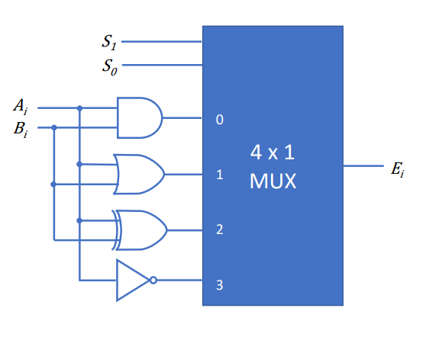
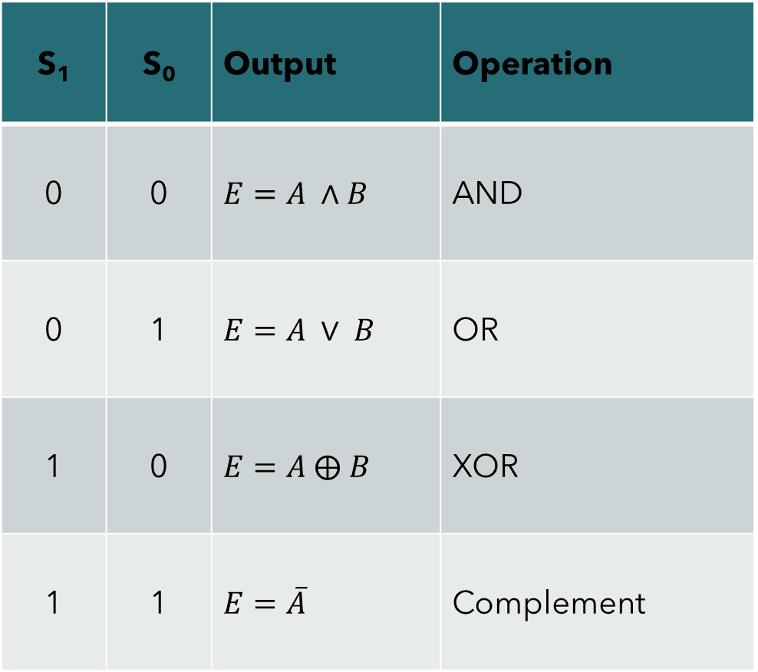
4 BIT LOGIC CIRCUIT
S₁ | S₀ | Output | Operation
0 | 0 | $$E=A ∧B$$ | AND
0 | 1 | $$E=A ∨ B$$ | OR
1 | 0 | $$E=A ⨁ B$$ | XOR
1 | 1 | $$E=\overline{A}$$ | Complement

Slide 9
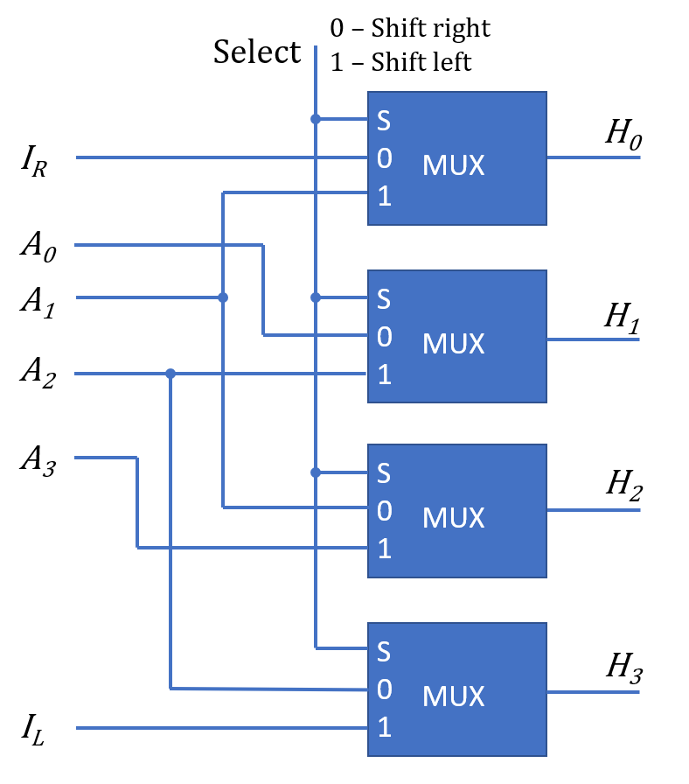
4 BIT COMBINATIONAL CIRCUIT SHIFTER
S | H₀ | H₁ | H₂ | H₃
0 | I_{R} | A₀ | A₁ | A₂
1 | A₁ | A₂ | A₃ | I_{L}

Slide 10
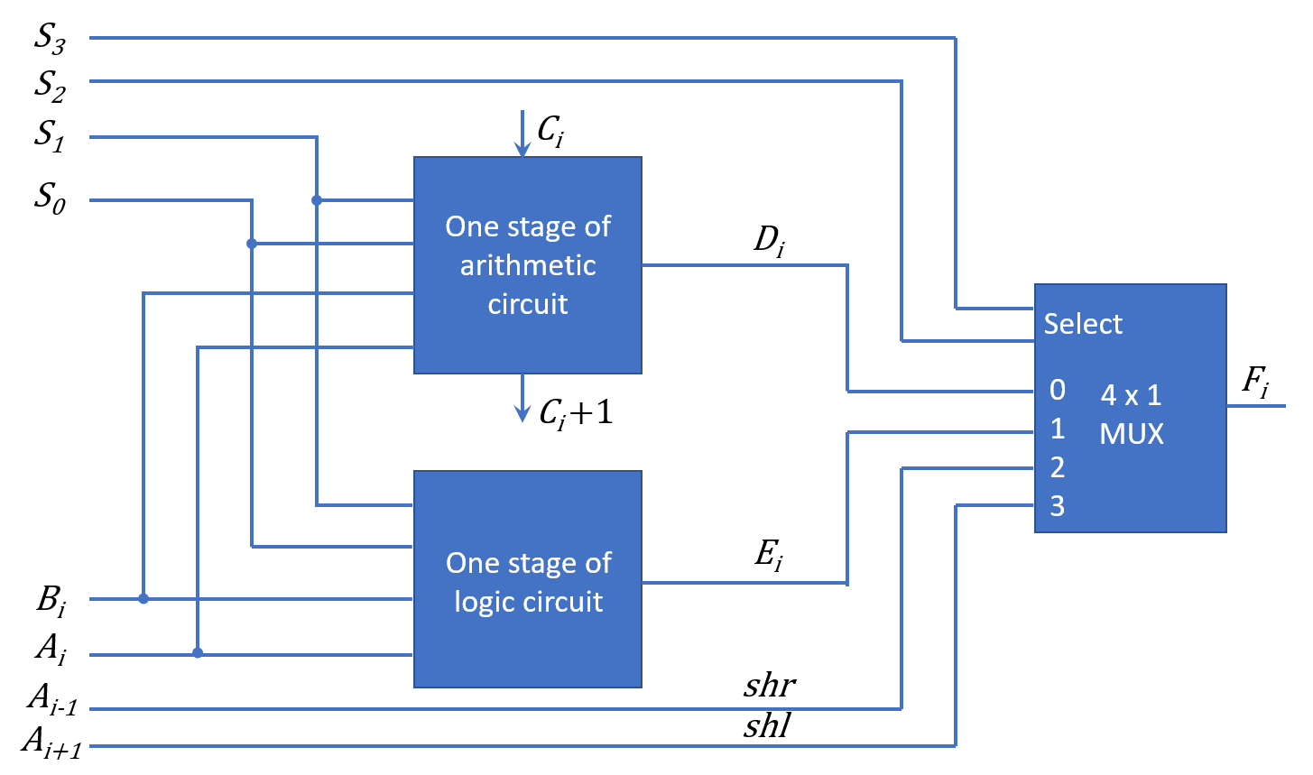
4 BIT ARITHMETIC & LOGIC SHIFT UNIT

Slide 11
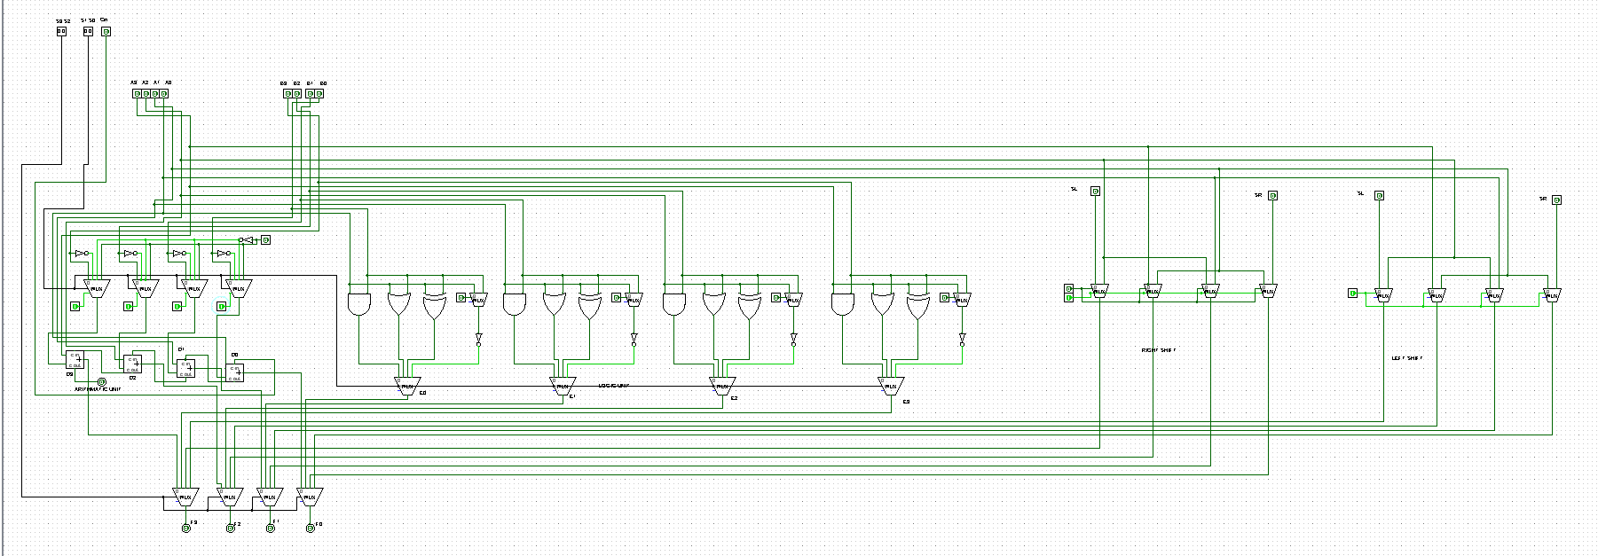
4 BIT ARITHMETIC & LOGIC SHIFT UNIT

Slide 12
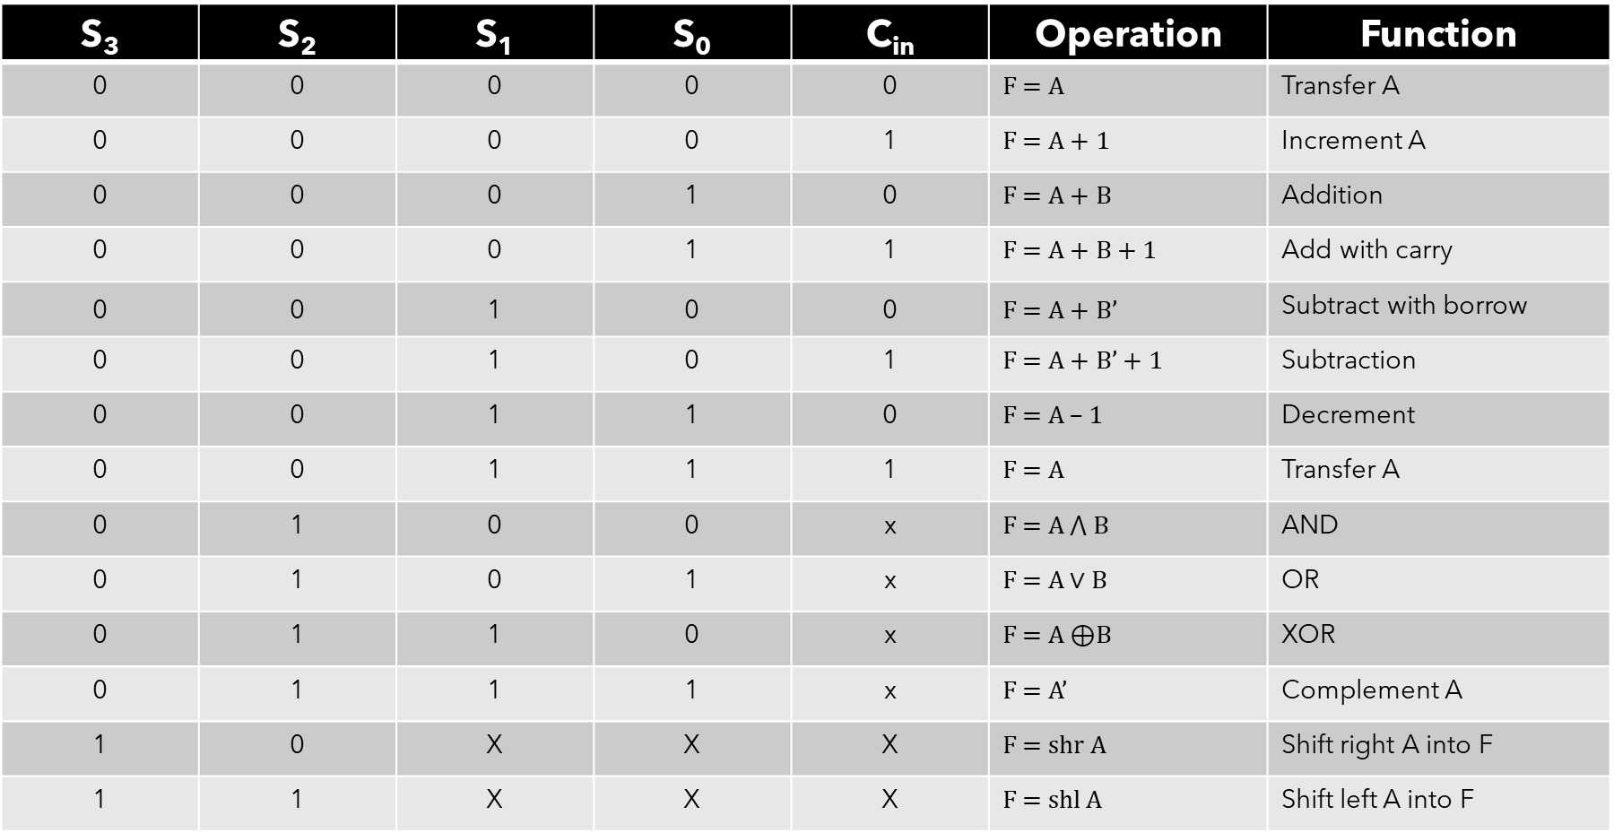
4 BIT ARITHMETIC & LOGIC SHIFT UNIT
S₃ | S₂ | S₁ | S₀ | C_{in} | Operation | Function
0 | 0 | 0 | 0 | 0 | F = A | Transfer A
0 | 0 | 0 | 0 | 1 | F = A + 1 | Increment A
0 | 0 | 0 | 1 | 0 | F = A + B | Addition
0 | 0 | 0 | 1 | 1 | F = A + B + 1 | Add with carry
0 | 0 | 1 | 0 | 0 | F = A + B’ | Subtract with borrow
0 | 0 | 1 | 0 | 1 | F = A + B’ + 1 | Subtraction
0 | 0 | 1 | 1 | 0 | F = A – 1 | Decrement
0 | 0 | 1 | 1 | 1 | F = A | Transfer A
0 | 1 | 0 | 0 | x | F = $A ⋀ B$ | AND
0 | 1 | 0 | 1 | x | F = $A∨B$ | OR
0 | 1 | 1 | 0 | x | F = A ⊕B | XOR
0 | 1 | 1 | 1 | x | F = A’ | Complement A
1 | 0 | X | X | X | F = shr A | Shift right A into F
1 | 1 | X | X | X | F = shl A | Shift left A into F

Slide 13
Conclusion
The exploration into the design and implementation of the 4-bit Arithmetic Logic Shift Unit (ALU) has highlighted its pivotal role as a cornerstone of computer architecture. Integrating an Arithmetic Unit, Logic Unit, and Combinational Circuit Shifter, the ALU stands as a versatile entity capable of executing arithmetic, logical, and shifting operations with utmost efficiency.
In summary, the ALU's multifaceted capabilities and its seamless integration within computer architectures underscore its paramount importance, emphasizing its vital role in the realm of data processing and computation.

Slide 14


Thank you

